Slide 1
Welcome

Slide 2
FOOD 2015
A catalyst for sustainable growth in the Belgian food sector

Slide 3
FOOD 2015 aims to be a catalyst for growth between now and 2015
Two clear objectives
Establish a growth agenda for the Belgian food industry
Provide a government framework
A platform with broad support
Co-developed with a high-level group of CEOs and directors of industry associations
A starting point, not an end point
A catalyst for a broader mobilisation process

Slide 4
We went through a comprehensive and inclusive process
Key activities | Timing
SWOT analysis | May
High-level group in Ghent | May 29
Scenario development | June
High-level group in Leuven | June 28
Strategy definition | July - August
Presentation to FEVIA federations | August 27
High-level group in Huy | September 5
Presentation to FEVIA Bureau | September 12
Presentation to FEVIA Board | October 10
Launch event at FEVIA annual meeting | December 6

Slide 5
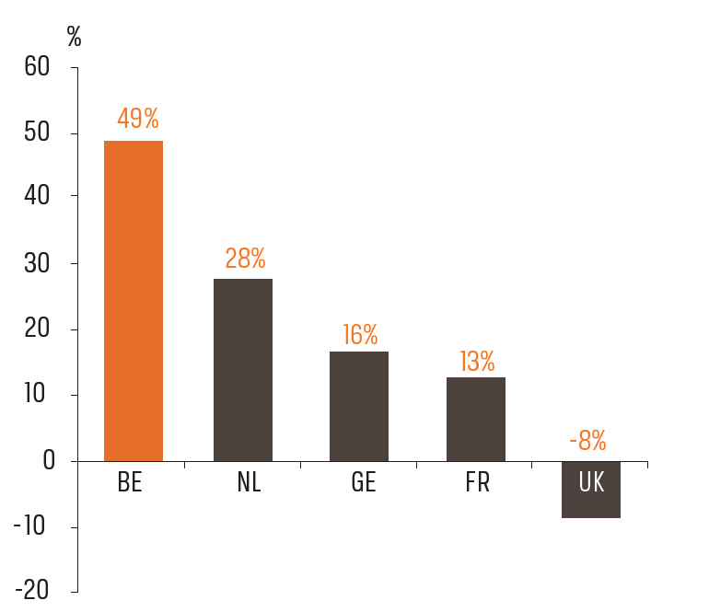
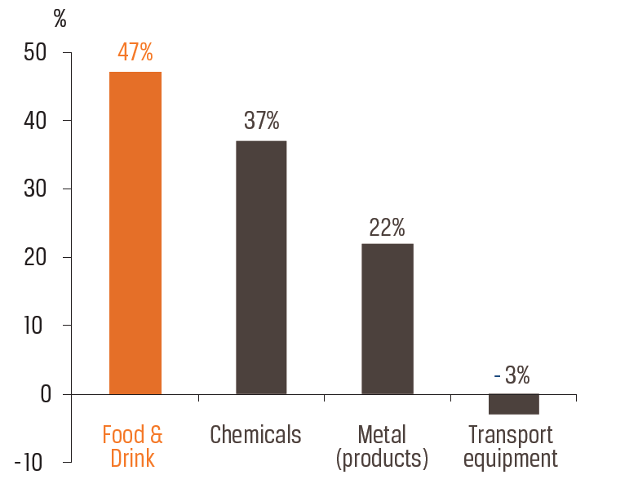
Belgian Food & Drink sector shows strong growth compared to other countries and sectors
Turnover growth in EU 2000-2009
Turnover growth in BE 2000-2010

Slide 6
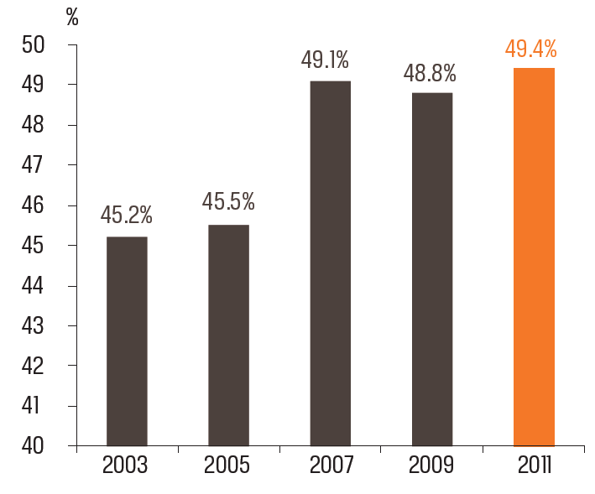
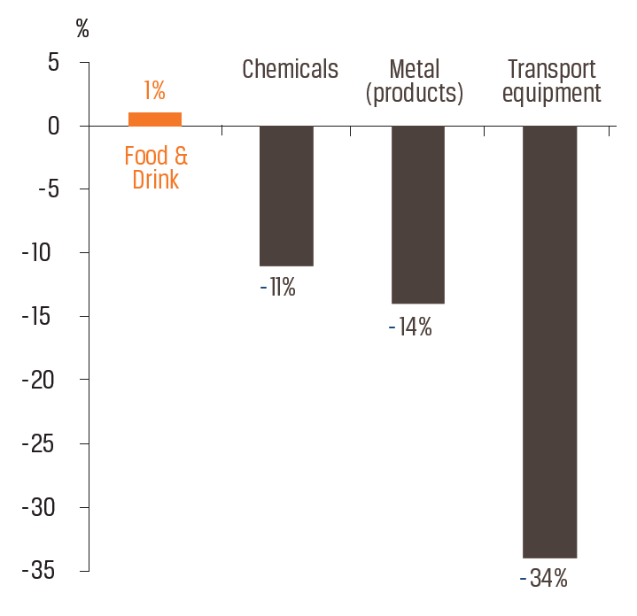
… while exports rise (as a % of turnover) and jobs are protected…
% export of total turnover
Employment growth in BE 2001-2011

Slide 7
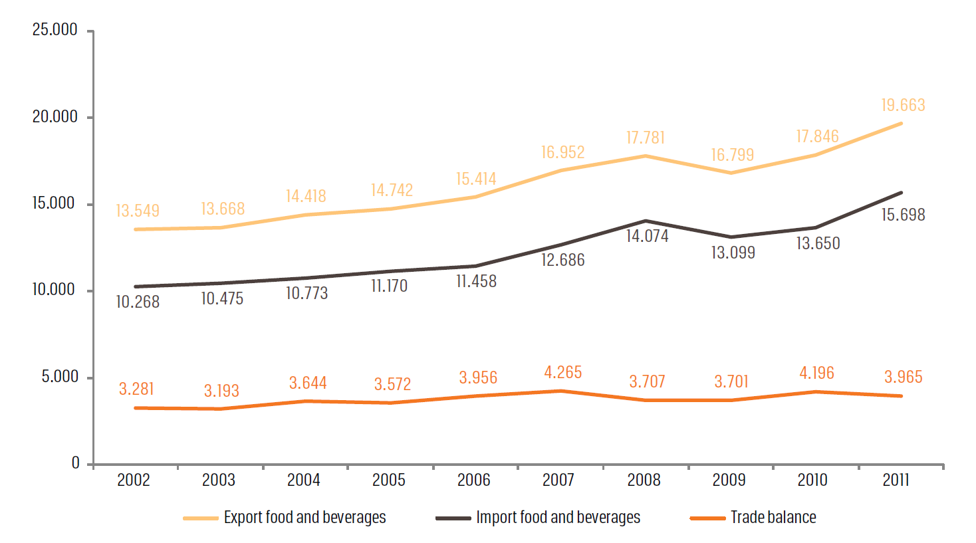
… and generating a trade surplus of €4 billion

Slide 8
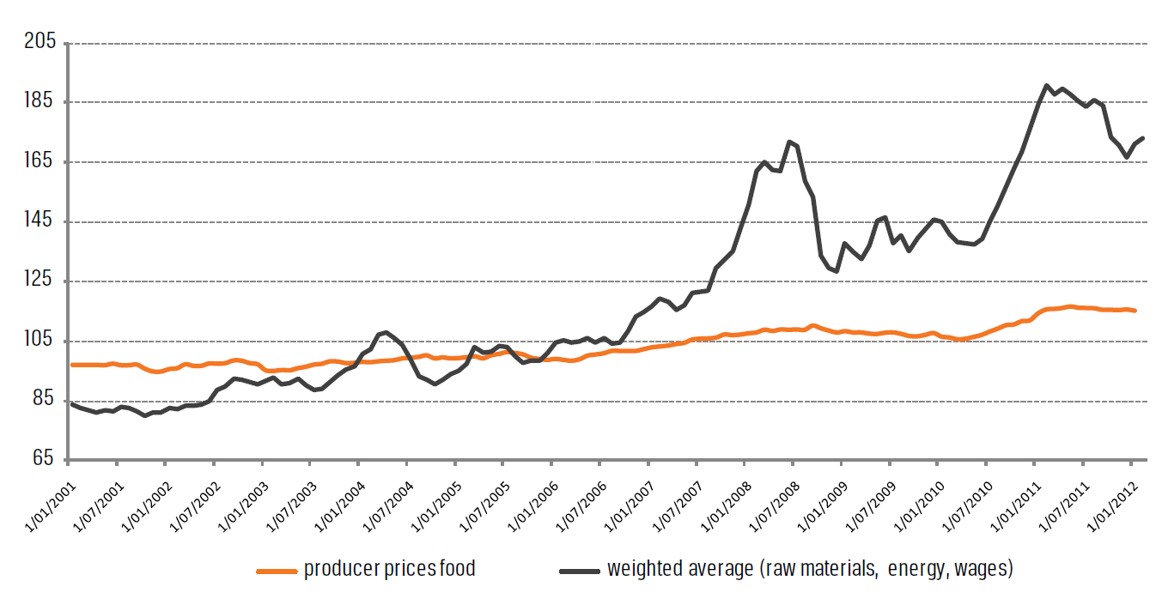
But… margins are under pressure as input costs grow at a much faster rate than producer prices

Slide 9
FEVIA as driving force for sustainable growth in the Belgian food industry
Members
Third parties
FEVIA as driving force
Link
Defend
Facilitate
Involve
Advise
Network
Strategic reports
(environment, health, economy)

Slide 10
… though some apparent weaknesses and threats, along with obvious strengths and opportunities
Strengths
Weaknesses
Belgian Food industry
Good knowledge of quality products
Geographic location in centre of Europe
Added value products
Value of sector insufficiently known at government level
High total cost for quality
Lack of big companies / decision
centres in BE
Opportunities
Threats
Increasing world population and shift in purchasing power
Civilisation diseases, food safety and healthy food
Internationalisation → Profit ↑
Scarcity of natural resources
Erosion of appreciation of quality

Slide 11
FOOD 2015: Vision and Strategy
3
+ €5bn
Exports
Branding
Communication
3-Tier strategy:
2
THE worldwide reference
point for excellence in food
1
We are proud of
the Belgian food sector
Starting point:
Quality
Innovation
Diversity
Most robust and fastest growing industry in BE

Slide 12
1. THE worldwide reference point for EXCELLENCE in food
Why?
Quality is key to success for the Belgian food industry
Continue and reinforce collaborative initiatives between FEVIA, its partner organisations and government bodies
How?
People | Attracting and training new employees as stable employer food@work projects in Flanders and Wallonia IPV-IFP, VDAB-FOREM-ACTIRIS, SYNTRA-IFAPME
Innovation | Market innovation (food chain) in line with consumer needs Gathering knowledge and insights on trends in food market Wagralim, Flanders’ Food, universities and high schools
Health and food safety | Benchmarking of food safety management Marketing of Belgian quality food Resource efficiency

Slide 13
2. Communication and Branding
Conveying our pride in and passion for our excellence in food,
which stems from our roots, heritage and diversity,
is a must for catalysing growth
Why?
Develop a strong message and engaging branding which shows that Belgium is THE worldwide reference point for EXCELLENCE in food
How?
Branding | Know how in Belgium to produce best quality food Branding through name, logo, baseline, brandography, keywords and key values
PR | ‘Belgian food industry is best kept secret’ PR campaign targeted at FOOD stakeholders
PA | Give Belgian food industry the place it deserves Joint public/private actions (VLAM – APAQ-W)

Slide 14
3. Grow Exports: +€5 bn by 2015
Why?
Given saturation on home market, exports a must for growth
Grow exports from €22 bn in 2011 to €27 bn in 2015
(internal turnover from €22 bn in 2011 to €23 bn in 2015)
Target?
Develop an export strategy, in collaboration with
the members and with the help of external experts
How?
Growth markets | BRICS, Next 11 Clubs of export managers International trade negotations
Competitiveness | Maintain competitiveness by controlling all input costs Improve logistics by increasing access to the ports
Cooperation | Collaboration with FIT, AWEX and Brussels Invest and Export (joint communication concept, joint stands at expos, market studies, etc Database and showcasing of Belgian food products Economic diplomacy, eg Belgian food at diplomatic receptions, etc

Slide 15
